Slide 1
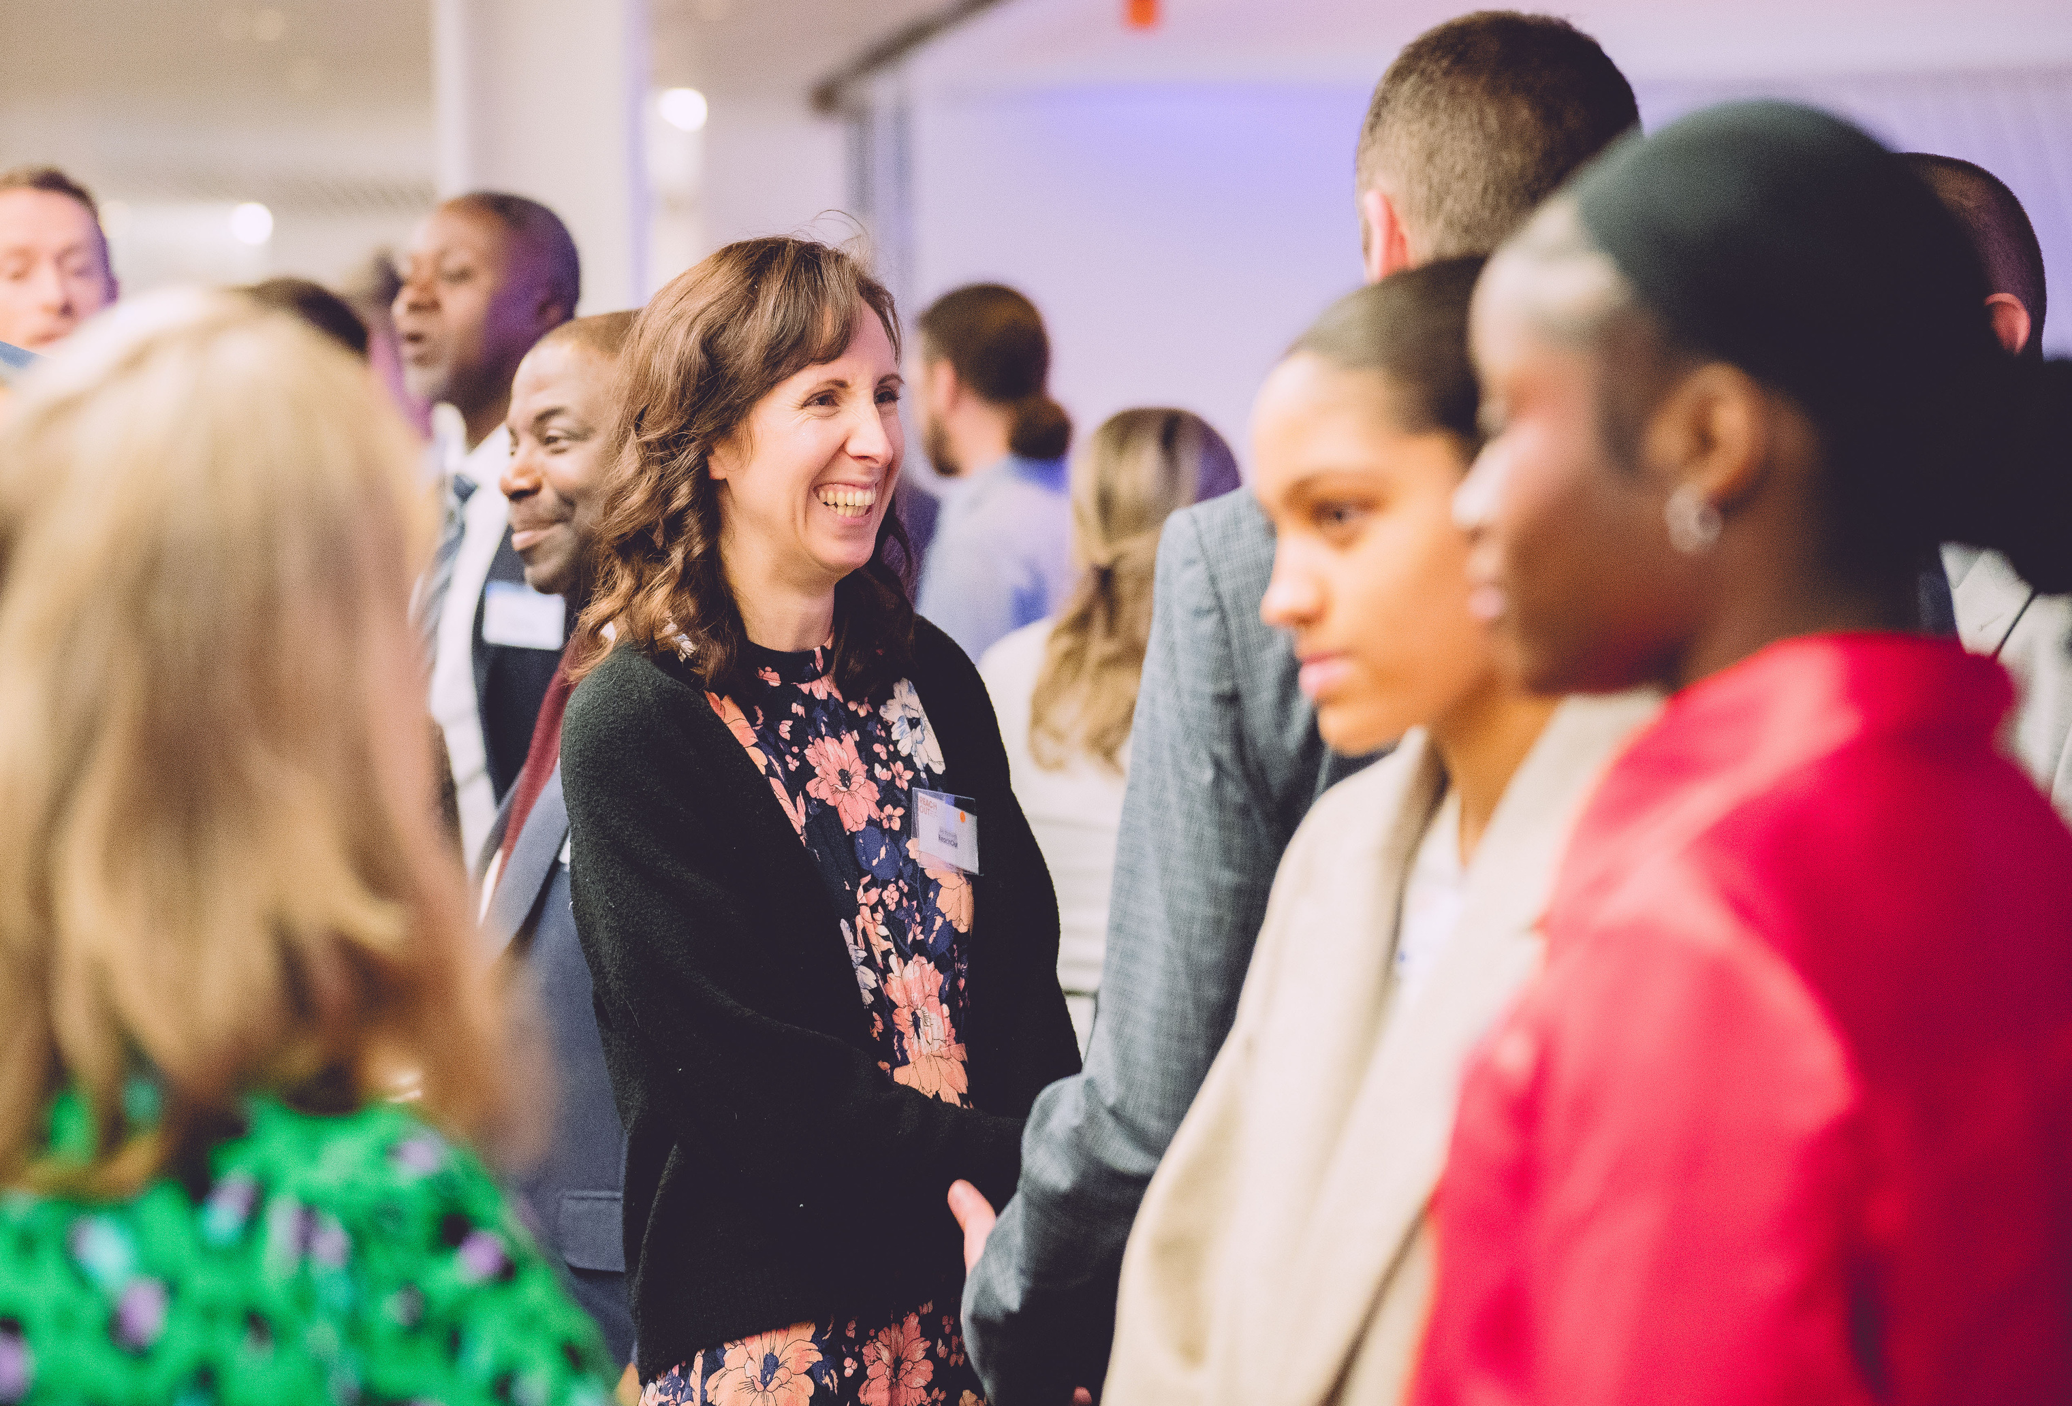

Guest Speaker: Your name
Notes:
How you can start this slide: “Hello everyone! My name is X. Do you know why I’ve come here today?/ I’m from X Company – have you ever heard of it? What do you think it is?”

Slide 2
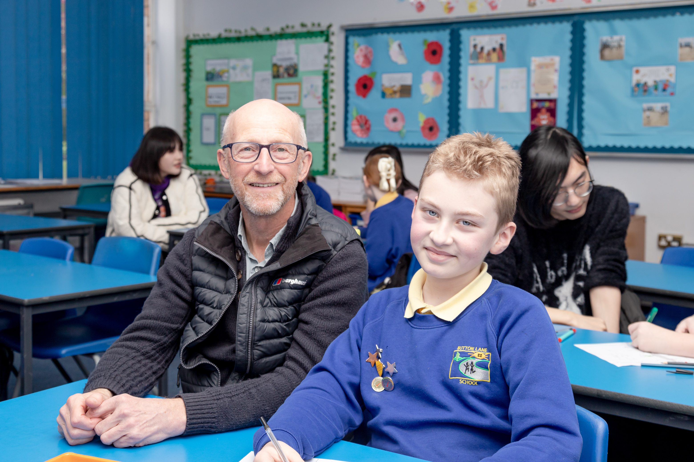
Section 1: Guess my job and my Journey
5-10 minutes
  Select one of the activities below. Take into consideration the Year group guidance, as well as any information you had on the group reactivity levels.
  Remember: Refer to the Briefing Doc when prepping, and if you have any questions or need guidance, get in touch with our team at susanna.allegretti@reachoutuk.org
Delete me
Before
presenting
  1
  2
  3

Slide 3
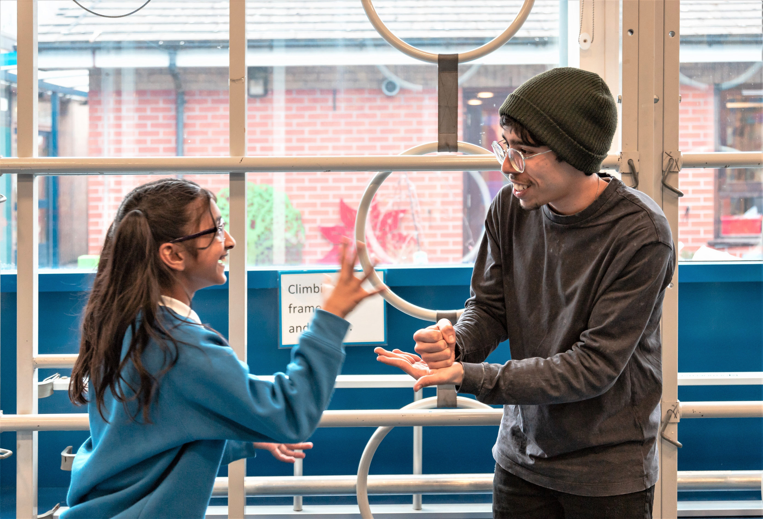
Guess the job in emojis!
Clue 1
Clue 2
Clue 3
I will work better for a primary group (Y5/6).
🏦
💰
📈
🎉
I am... an Investment Banker!
Notes:
Some examples below:
💼 Investment Banker
🏦 (bank)
💰 (money bag)
📈 (chart going up)
🌍 DEI Specialist
(Explained simply: someone who helps people feel included and work well together)
🤝 (working together)
🌈 (everyone is welcome)
🗣️ (listening to different voices)
🏗️ Construction Manager
🏗️ (building site)
👷 (builder)
🔧 (tools)

Slide 4
Guess the job Rebus!
IN
MENT
I will work better for a secondary primary group (Y 7-8).
🦺
🏦
🏥
🎉
I am... an Investment Banker!
Notes:
Some examples below:
💼 Investment Banker
🏦 (bank)
💰 (money bag)
📈 (chart going up)
🌍 DEI Specialist
(Explained simply: someone who helps people feel included and work well together)
🤝 (working together)
🌈 (everyone is welcome)
🗣️ (listening to different voices)
🏗️ Construction Manager
🏗️ (building site)
👷 (builder)
🔧 (tools)

Slide 5
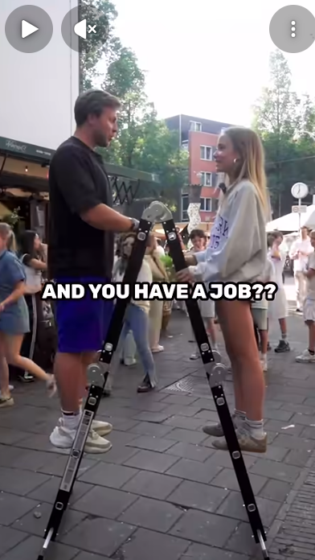
Career Ladder!
🎉
I am... an Investment Banker!
Instructions
Mentees take it in turn to ask questions for two minutes to try and guess the job of the speaker.
YDL to set a timer and stop questions, and facilitate guessing.
I will work better for a secondary group (Y 9).
Notes:
Discuss job, discuss type of people I work with and why.
Investment analogy - If you eat an apple, it’s gone. If you plant the seed, you get a tree. The tree gives apples every year. It’s about waiting and helping things to grow, i.e. trading effort now for something better later.
“Which skill do you think I use the most?”
“Which do you already use at school?” for example, looking after belongings (responsibility), decision making, maths
“What job sounds interesting to you right now? Doesn’t have to be my job!”

Slide 6
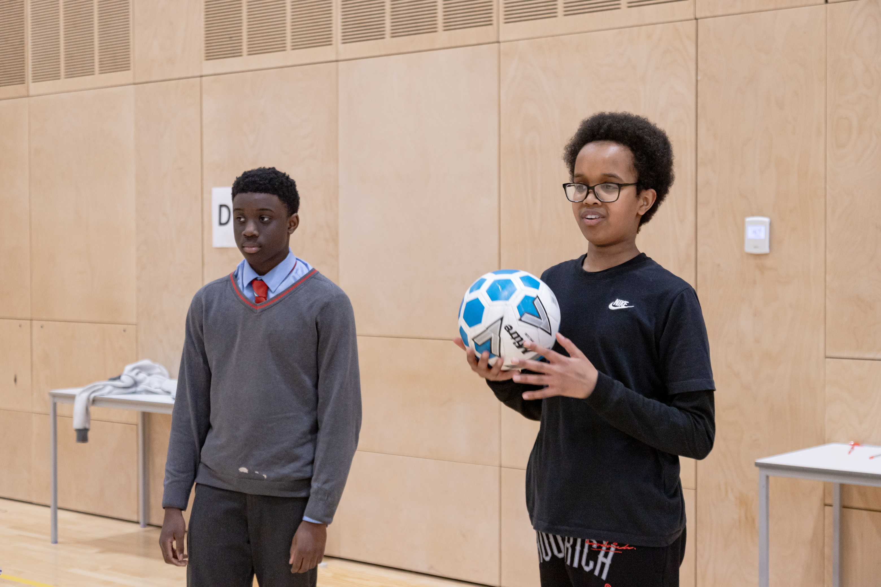
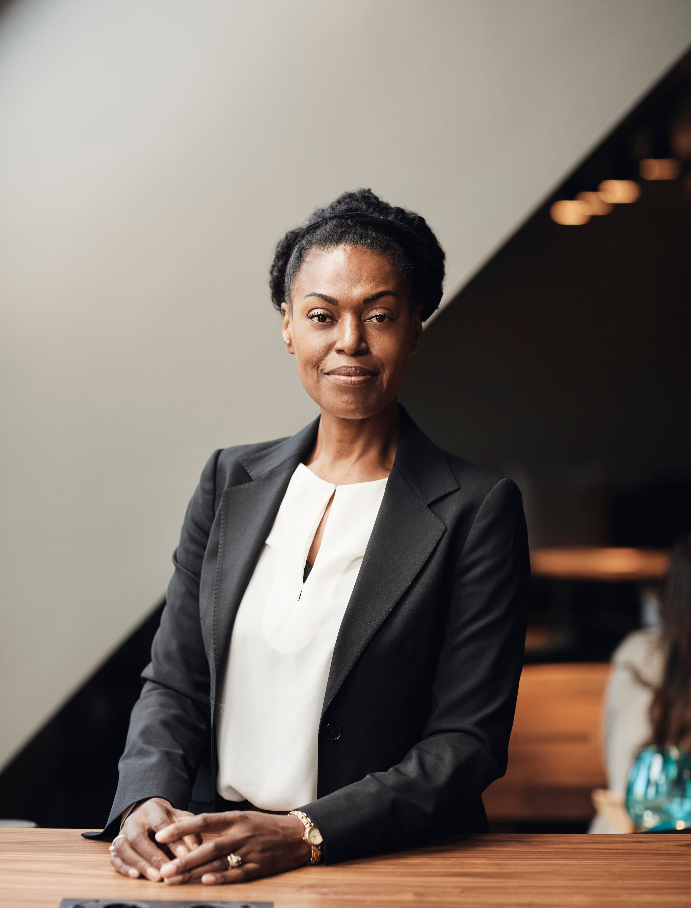

My Journey...
Step 5
Step 1
Step 3
I went to college and Uni and worked very hard to get better at it, and eventually found it enjoyable
For example, I have worked as a waitress, I have worked in a bar, I have worked in a restaurant
When I was younger, I went to a school just like this one.
Step 2
Step 4
My job now
I loved reading but when I was young, I wasn’t actually very good at maths!
To prepare for my job, I did a LOT of work experience
Now, I am an investor – something I couldn’t picture when I was your age!
Notes:
Discuss not being good at maths when younger but getting better
Disuss putting in the ground work to gain work experience – list examples of jobs

Slide 7
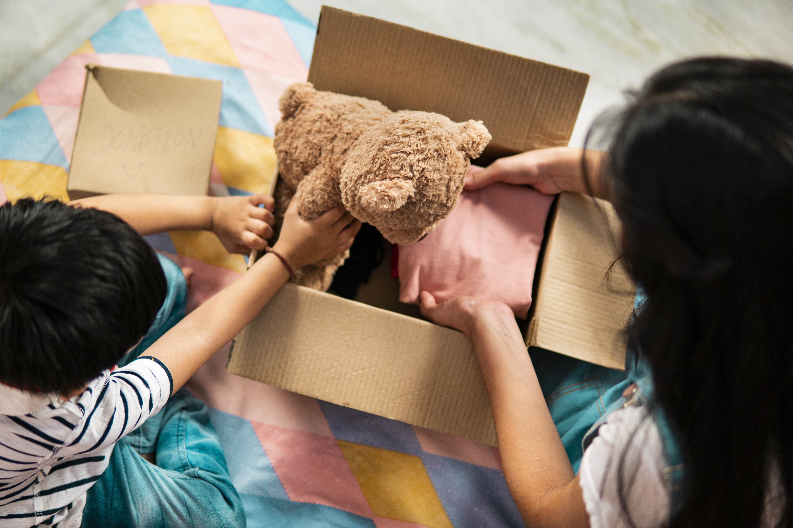

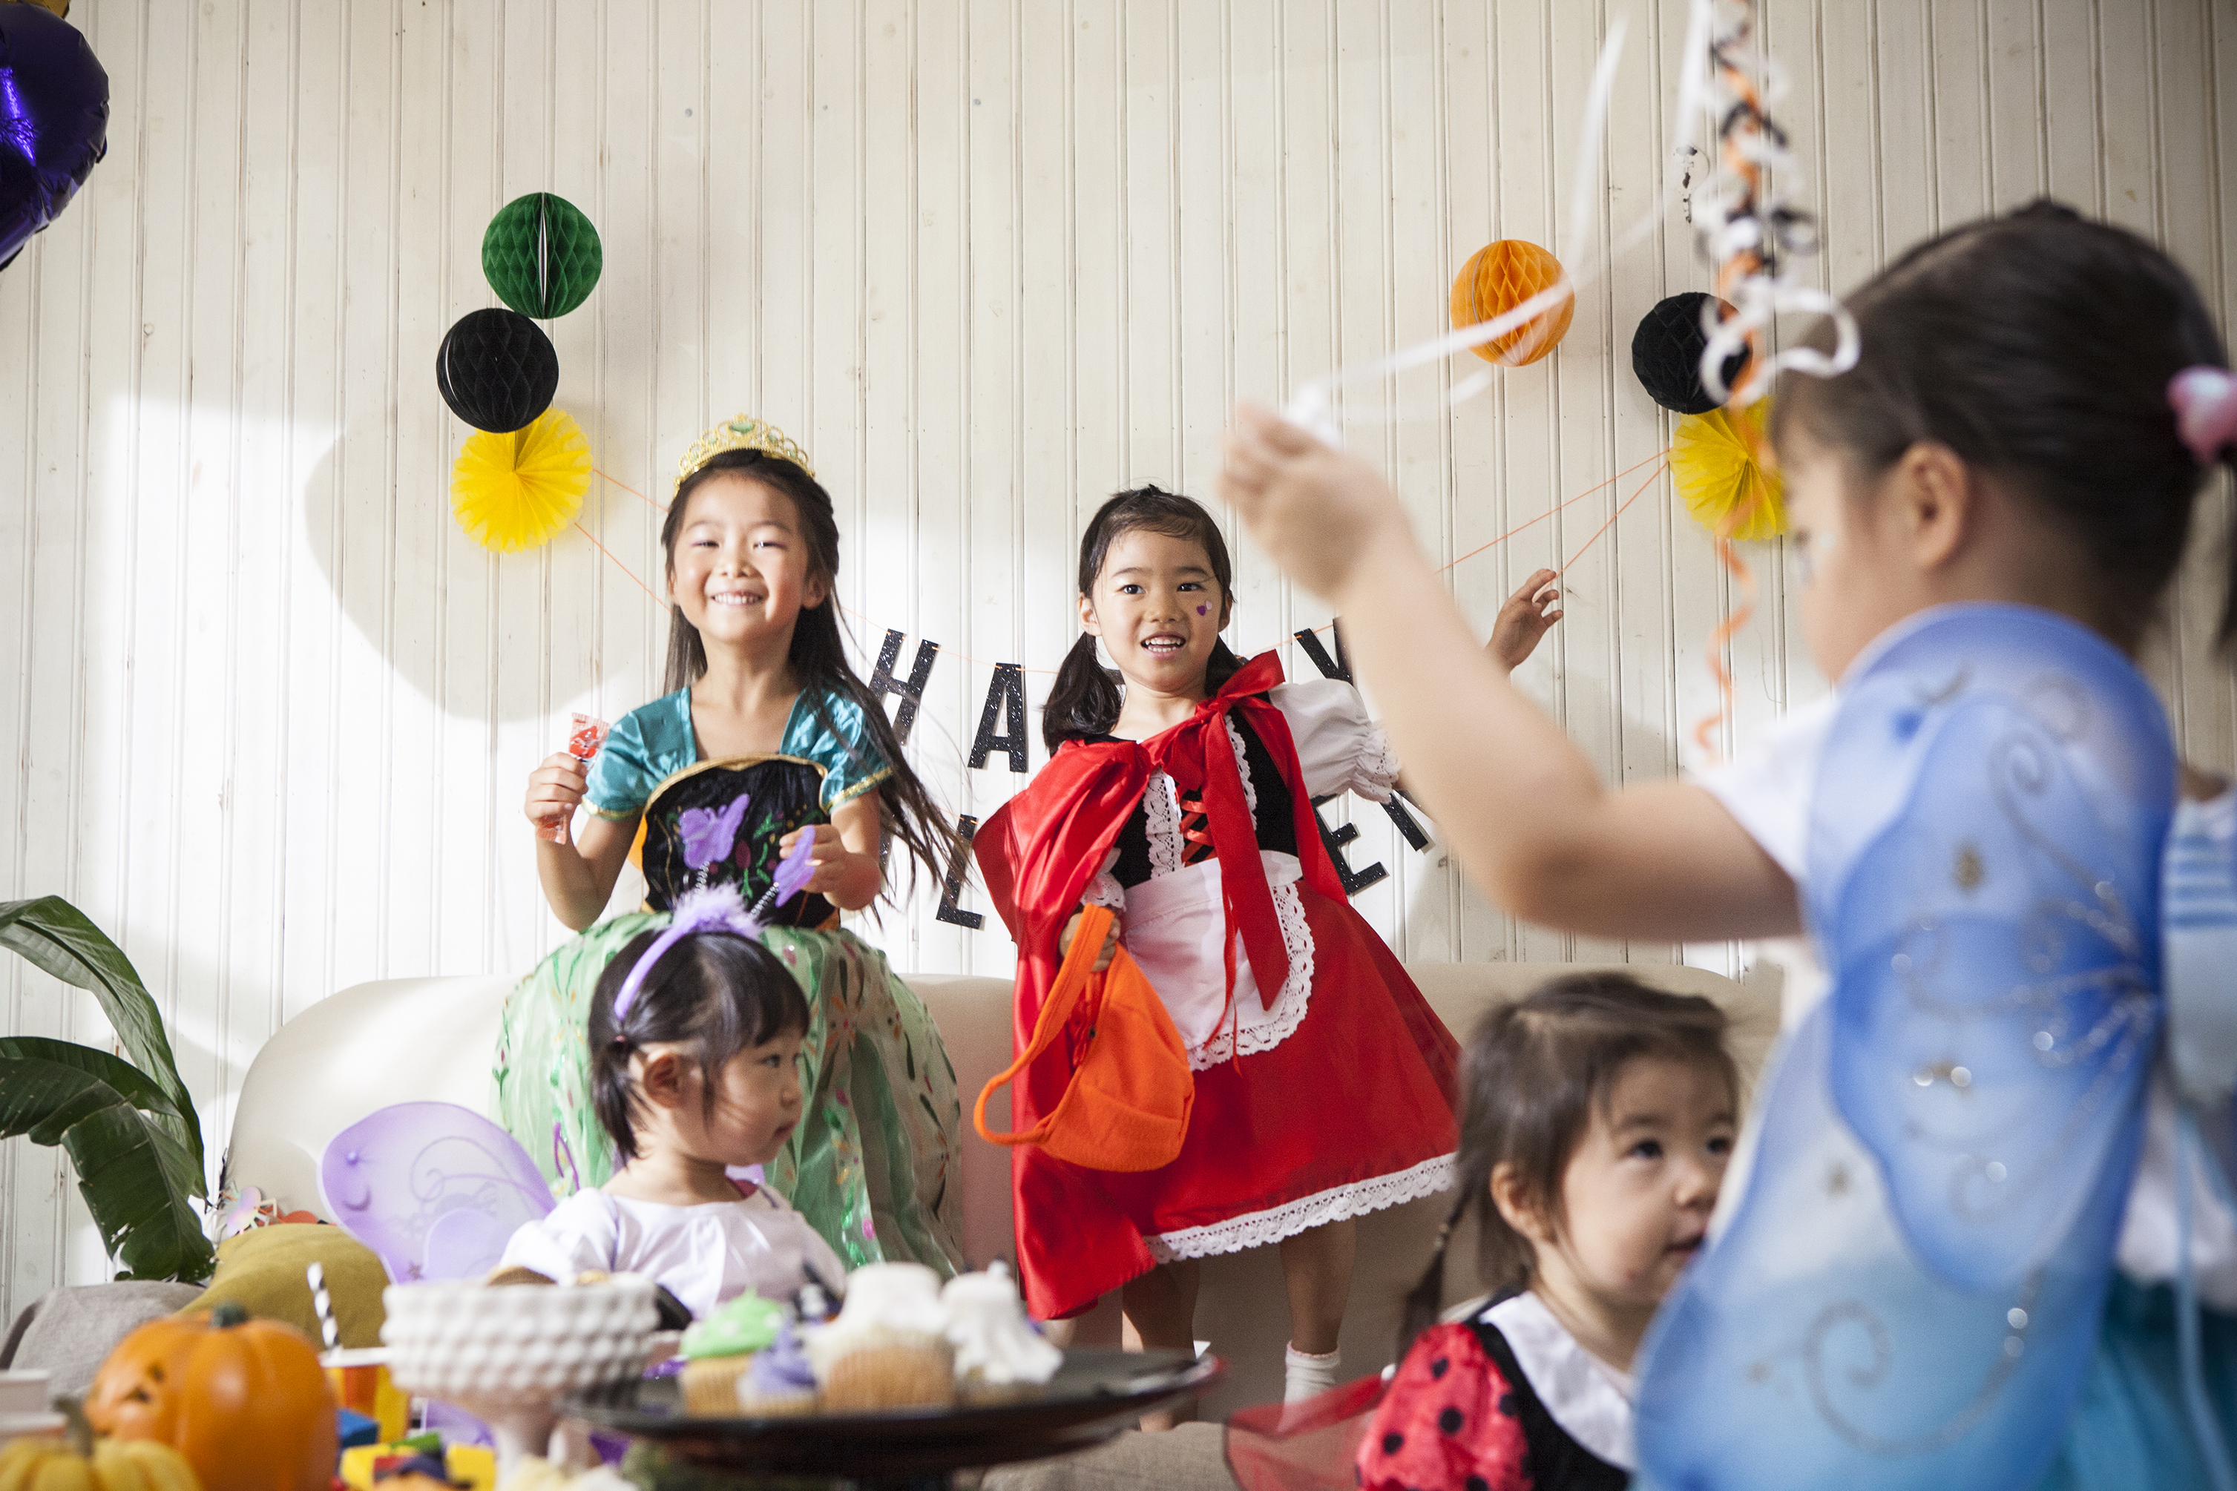

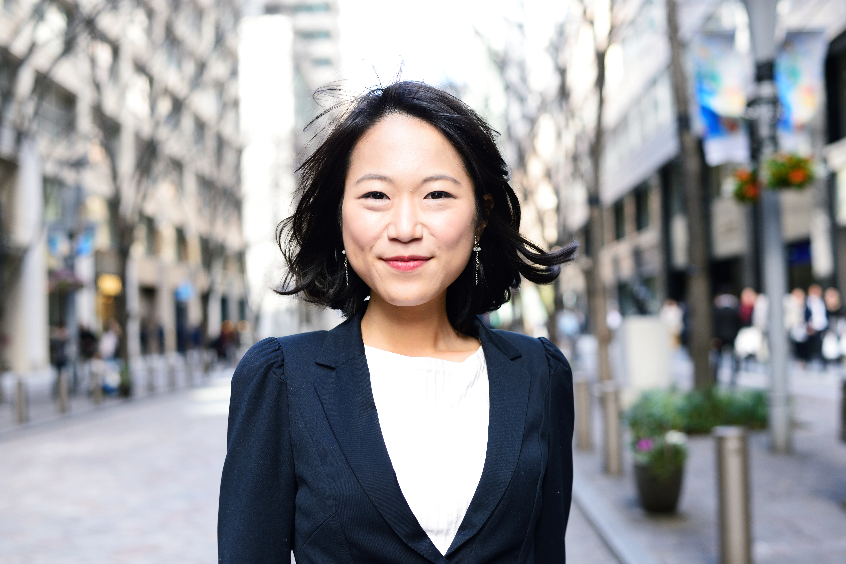
Our Journeys...
Two speakers
Moving to the UK
Leaving school at 16
I grew up in a different country, and came to the UK when I was 8 years old. At first, I struggled to learn English and felt quite alone at school.
I left school when I was 16 as I found studying really difficult, especially subjects like maths and science.
Apprenticeship
Building relationships
I worked for a year, and then found that there was a practical way to learn the skills I needed for my current job that fit the way I like to learn.
I think this experience shaped me into who I am today as every day as I have become an expert at building relationships
My job now
My job now
Now, I build relationships every day in my job as an Account Manager!
Now, I am an investor – something I couldn’t picture when I was your age!
Notes:
Discuss not being good at maths when younger but getting better
Disuss putting in the ground work to gain work experience – list examples of jobs

Slide 8
Section 2: Activity ie. The Investment Game
10 minutes
  A chance to show our young people more about your job, and what it looks like in practice. We've included an example below – you can work with our team to devise an interactive exercise in our prep session.
  Remember: Refer to the Briefing Doc when prepping, and if you have any questions or need guidance, get in touch with our team at susanna.allegretti@reachoutuk.org
Delete me
Before
presenting
  1
  2
  3

Slide 9
First question – who in this room likes money?
Next question – what would you do with it?
Final question – what if you could make more…?
Notes:
“Who likes money? Hands up!”
“Imagine you win £1,000… you have been very lucky and have been given a lottery ticket. Amazingly you win £1,000”
Ask: Would you spend it?
Save it?
Try to make more?

Slide 10
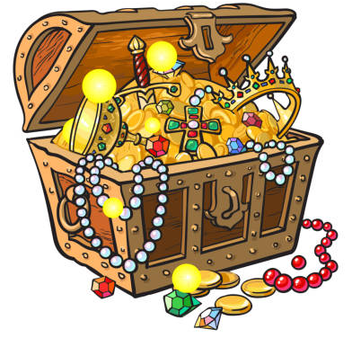
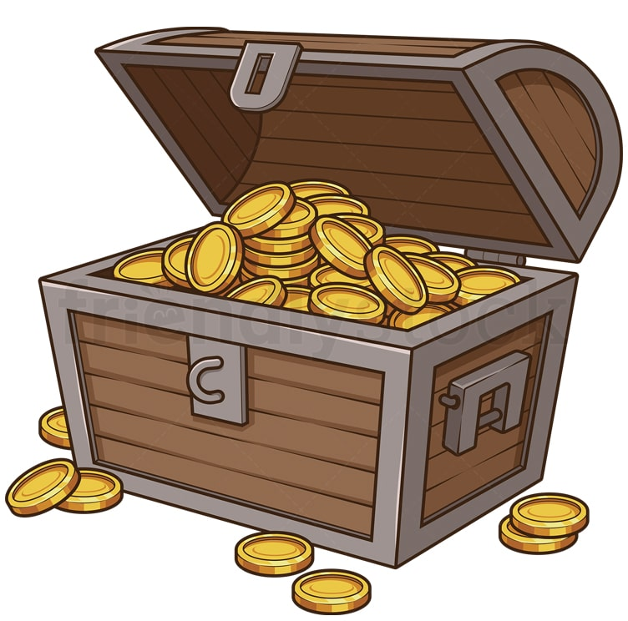

The Investment Challenge
You have £1,000… but you can only pick ONE treasure chest!
Option 1 – The Adventure Chest
Option 2 – The Safe Chest
Option 3 – The Mystery Chest
High Risk
💥 Might turn into £2,000!
💀 Might turn into £0…
Very exciting — but dangerous
Low Risk
🌱 Grows a little bit every year
🛡 Very unlikely to lose money
Boring… but safe
Medium Risk
🎢 Sometimes up
🎢 Sometimes down
In the middle
Notes:
After voting, ask:
“Who chose A because they want to get rich fast?”
“Who chose B because they hate losing?”
“Who chose C because they want balance?”
Different people choose different risk — and none are wrong.

Slide 11
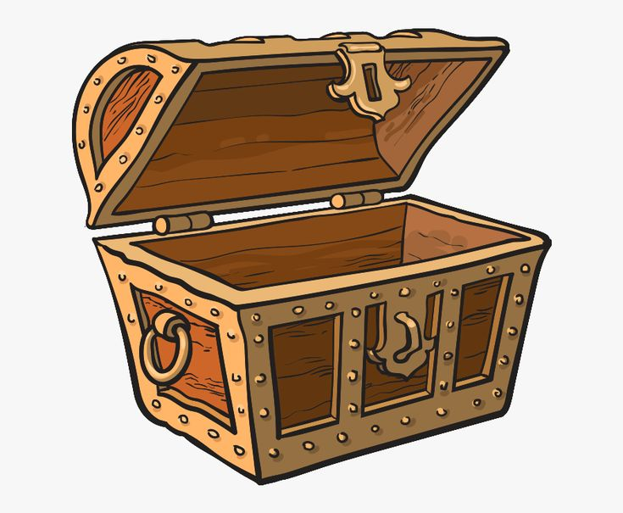
The Investment Challenge
🌍 OH NO! The Market Crashes!
Option 1 – The Adventure Chest
Option 2 – The Safe Chest
Option 3 – The Mystery Chest
💥 Company fails
Your £1,000 → £0
🌧 Nothing exciting happens
Your £1,000 → £1,050
📉 Bad year
Your £1,000 → £700
Notes:
How do you feel right now?
After revealing results, ask them to stand up based on their reaction:
Lost everything → put hands on head 😱
Lost some → sad face 😟
Small gain → shrug 😐
Ask “Who wishes they picked a different one now?”
The hardest part of investing is not maths — it’s emotions.
If someone “loses all their money”, In real life, my job is to stop that happening by using XYZ skills
Discuss responsibility and emotions

Slide 12
Section 3: Skills and Reflection
10 minutes
  This section is devised to connect the information mentees learnt about your career and industry back to the skills they are developing in sessions, and their experience. There is also a section for questions.
  Remember: Refer to the Briefing Doc when prepping, and if you have any questions or need guidance, get in touch with our team at susanna.allegretti@reachoutuk.org
Delete me
Before
presenting
  1
  2
  3

Slide 13
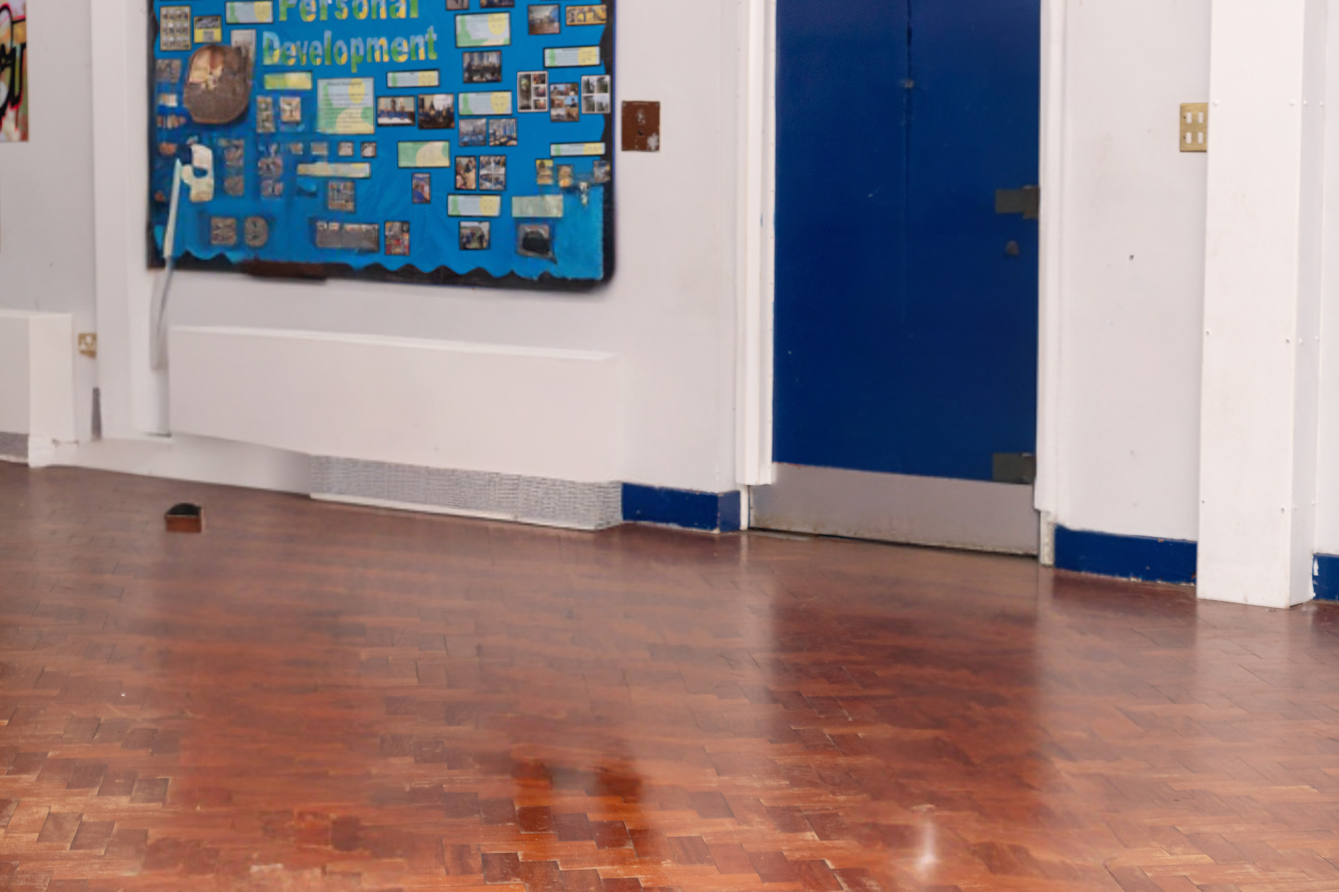

Skills Match Up Relay!
Match the actions I do every day to the relevant skill!
Emotion Management
Responsibility
Empathy
Teamwork
Problem Solving
Initiative
Notes:
Get young people to reflect on how the skills they’re learning now at ReachOut could help them in the future, to achieve a job such as your own.
How you can start this slide: “ So now you’ve learnt about me, I’d love to hear from you! I know you are familiar with the skills above, which ones do you think I use the most in my day to day and how?”

Slide 14
Q&A & Reflection
Reflection Prompt:
Write on a piece of paper why you think you’d be great at my job! Then your Speaker will help you to share some ideas.
What does your average day look like?
What’s one piece of advice/tip you wish you’d been told when you were younger?
What is the most challenging thing about your job, and how do you overcome it?
Where can I find more information about this career?
What job might you do next?
Notes:
Self-control - Not spending all your pocket money on day one
Patience - Waiting to buy something bigger later
Planning - Saving for a game instead of buying sweets every day
Responsibility - Looking after something you own
A socio-economic skill is a life skill that helps someone manage both Social situations (people) and economic situations (money, choices, future planning)

